Slide 1
Customer Service Variance
(CSV)

Slide 2
CSV and its purpose?
Management model that provides complement, workhour, productivity, workload and route/delivery analysis. It calculates actual versus earned workhour performance against standardized target productivity expectations and trends performance from national results to the unit level.
CSV is the Function 4 model in the suite of Variance Programs for Cost Ascertainment Grouping (CAG) A-G offices. This is the parent application to additional F4 programs including:
Customer Service Staffing Opportunity Model (CSSOM)
F4 Lean Matrix
Performance management tool used to right size complement and identify work hour reduction opportunities down to the unit level. The model relies on accurate data from multiple sources and manual inputs. The Variance Programs output is only as valuable as the data supplied.

Slide 3
CSV Data Sources
• End of Run (EOR)– Automated/Mechanized Volumes
• eFlash – Manual Distribution Volumes, PO Box Volumes and Work hours
• Window Operations Survey or (WOS) – Earned Hours and Workload
• WebBATS – Number of Callers
• Address Management System or (AMS) – Numbers of Routes and Deliveries
• WebCOINS – On Rolls Complement and MPOO Designation
• Facilities Database – Office Level

Slide 4
Workload Associated by Labor Distribution Code (LDC)
LDC 41- Automated operations (Delivery Point Sequence (DPS), Automated Delivery Unit Sorter (ADUS) and Small Delivery Unit Sorter (SDUS)
LDC 42- Business services related to Business Reply Mail (BRM), Postage Due (PD), Merchandise Return Service (MRS) and Parcel Return Service (PRS)
LDC 43- Manual distribution operations (Letters, Flats, Parcels and Allied distribution)
LDC 44- PO Box distribution operations (Letters, Flats, Box parcels and Delivery Point Sequence)
LDC 45- Retail window operations
LDC 48- Allied back-office function four administrative duties

Slide 5
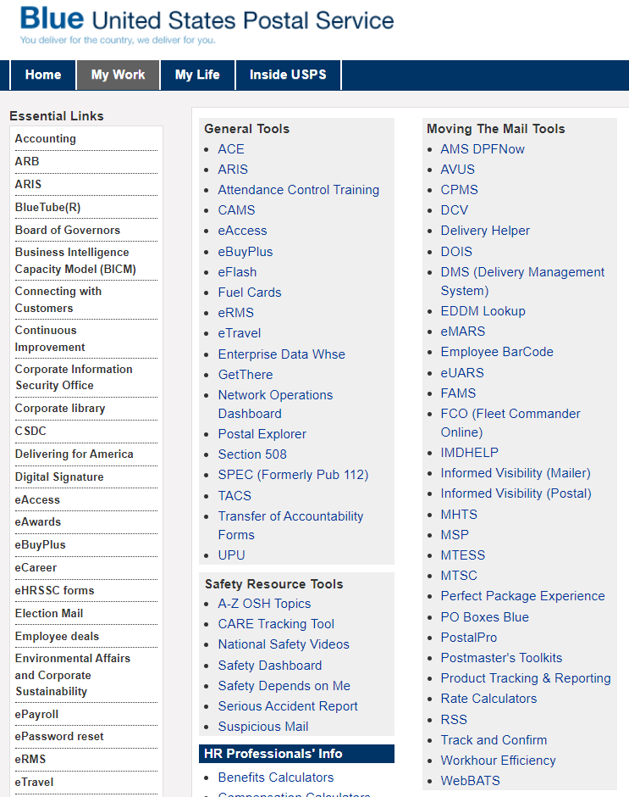
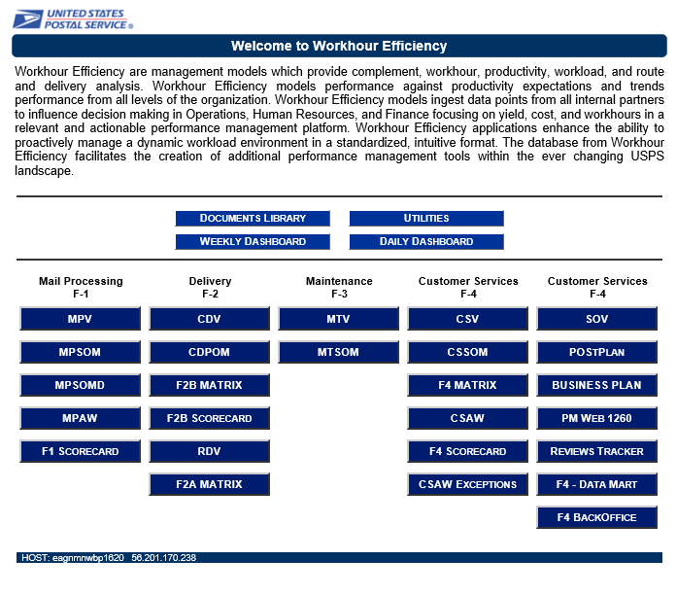
CSV Sign-In
Blue Page
“My Work”
“Workhour Efficiency
CSV

Slide 6
Search Page
Select the Area
Select District
Select MPOO/Group (If Known)
Lead Unit (If MPOO/Group Selected)
Select View Range:
Canned Reports or Ad Hoc Reports
Canned Reports allows you to select from the 5 date ranges as shown
Ad Hoc Reports allows you to pick your specific date range
Submit Query

Slide 7
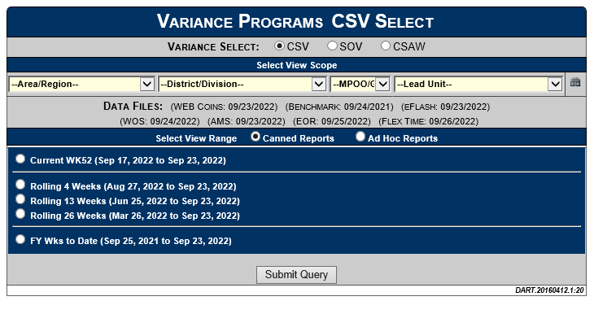
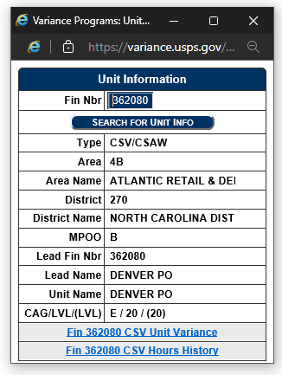
Search Page (If Finance # Is Known)
If the finance # is known, click on the binocular's icon
Enter the finance number and search for unit info
Click on Unit Variance link at the bottom
Indicates the variance model of the finance number - CSV/SOV

Slide 8
Customer Service Variance Summary
Provides an overview based on selected scope chosen from the search page
Provides an LDC work hour analysis for Function 4 operations
Provides a breakdown of each LDC percent achieved and complement analysis for each office with the scope selected

Slide 9
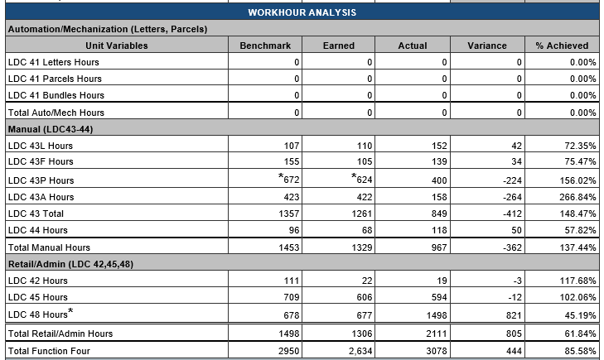
Workhour Analysis Section
Comparison of actual vs. earned and benchmark workhours
Earned workhours- generated from workloads by LDC based on productivity expectations for each work element
Actual workhours- time reported for completed workload related to each LDC.
Sourced from Time and Attendance Collection System (TACS) through eFlash
Divided into three groups:
Automation/Mechanized – LDC 41
Manual Work Hour – LDC 43 & 44
Retail/Administrative – LDC 42,45 & 48

Slide 10
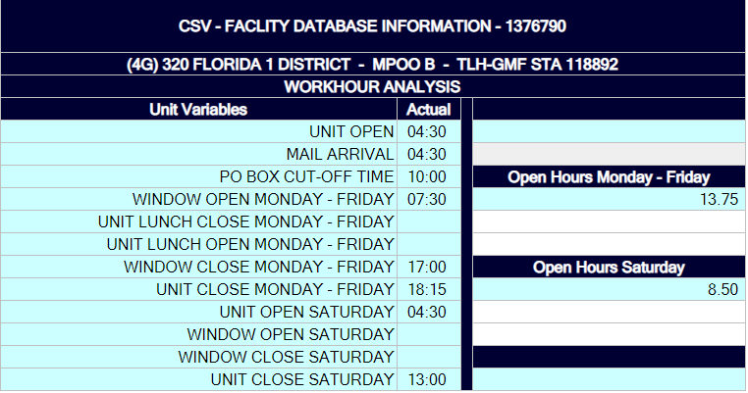
CSV Menu - FDB
Provides information on Unit Times.
Facility Database ID associated to the facility/finance number selected is displayed.
Discrepancies are to be reported to the Variance group through the Retail and Post Office Operations Field Support for correction
**It is important to verify that the correct FDB ID is displayed so that this facility information is correct

Slide 11
FTES Daily Staffing Analysis
Comparison of actual vs. earned and benchmark FTES
Earned FTES- Calculated by dividing the total earned hours by 6.6179 divided by number of days for the report period
Actual FTES- Calculated by dividing the total earned hours by 6.6179 divided by number of days for the report period
Need to reduce hours

Slide 12
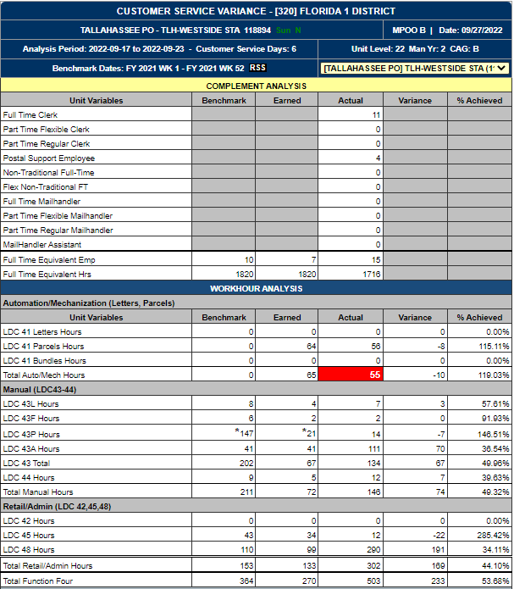
CSV Menu
Hovering over this icon will open more options, for further analysis

Slide 13
CSV Other Reports - Menu
Provides additional supporting reports and data
Available menu options will vary depending on the unit selected
Items in menu allows a deeper view into the data and workload related to LDC 42, 45 & 48
Provides a deeper analysis of complement, productivity factors, workload analysis and other workstreams specific to the office selected

Slide 14
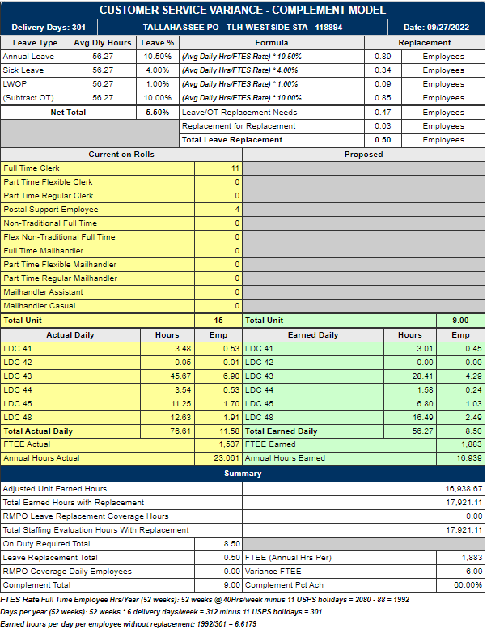
CSV Menu - Complement Model
Based on 301 Delivery days
Leave Replacement-
Calculated by type of leave and overtime percentages times the average daily earned hours
Proposed complement-
Provides proposed earned FTES using earned hours for the previous 301 days
Average daily earned hours and FTES by LDC
Calculates annual earned hours based on daily average times 301 days
Actual complement-
Employees on rolls from webCOINS
Actual average daily hours and FTES used by LDC
Summary Section

Slide 15
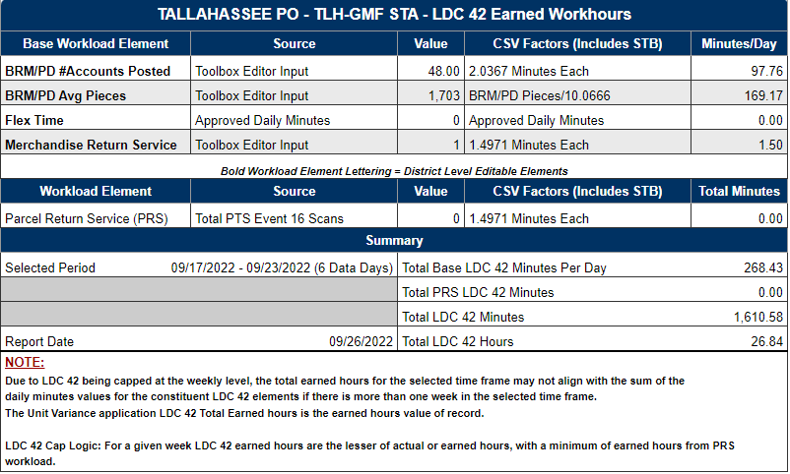
CSV Menu – LDC 42
Safety Talks & Breaks (STB)
Provides a summary of the calculations for the report period for Business Return Services.

Slide 16
FY 2023 -LDC 42 Business Services Metrics

Slide 17
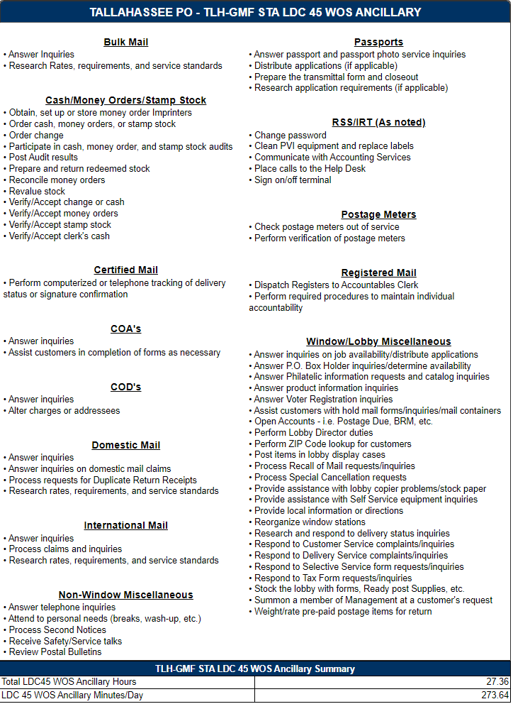
CSV Menu – LDC 45 Ancillary
Frequently referred to as “soft time”
Provides a list of activities that are performed as part of LDC 45
33% of earned transaction time is allocated for Ancillary activities; i.e. for every 45 minutes of earned transaction time a unit earns an additional 15 minutes.

Slide 18
FY 2023 -LDC 45-Retail Window Service Metrics

Slide 19
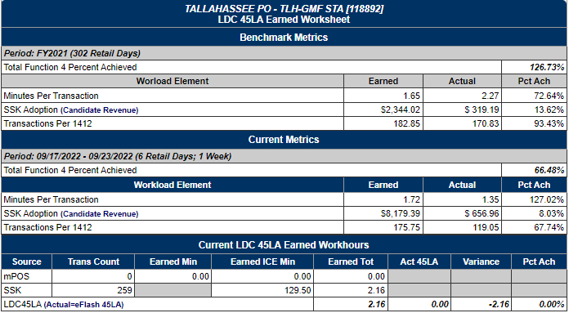
CSV Menu – LDC 45 LA
Applies to offices with:
Self-Service Kiosks (SSK)
Automated Postal Centers (APC)
Mobile Point of Sale (mPOS)
Provides information on the calculations used to determine earned workhours for lobby assistance

Slide 20
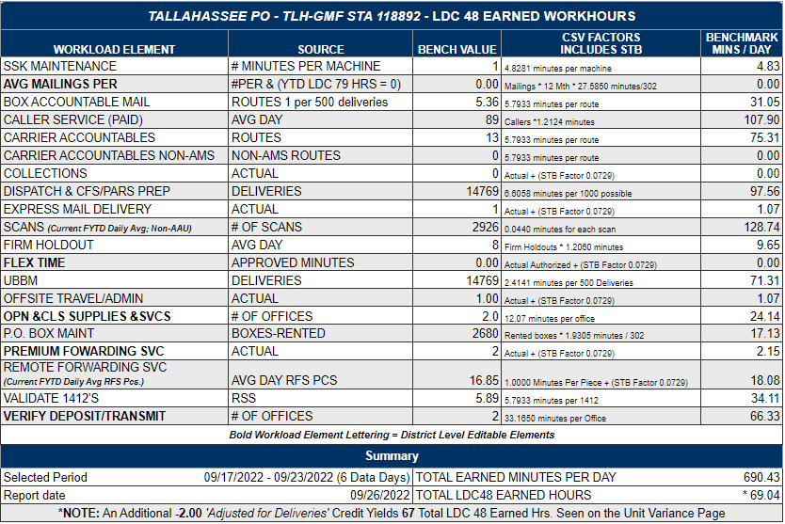
CSV Menu – LDC 48 Postal One / Validate collection pickups, PFS amount,
Provides in depth breakdown of LDC 48 earned hours by individual metric
Bench value only updated at the beginning of each fiscal year except for items in bold
Earned hours = bench value times work element metric for each workload element
Provides total earned minutes per day for the reporting period selected.
Converted to hours per day by dividing by 60 minutes

Slide 21
FY 2023 -LDC 48-Administrative Backoffice Metrics

Slide 22
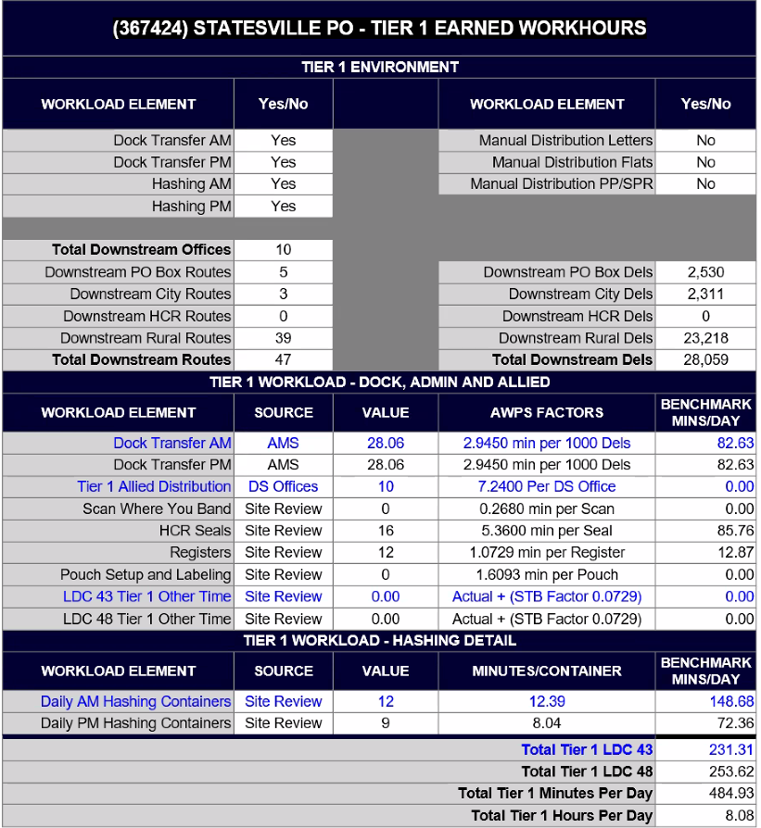
CSV Menu – SCF Hub
Specific to offices identified as SCF, Tier 1 or Tier 2 Hub
SCF- site identified by plant processing of automated mail service to 3-digit service area. SCFs are predefined by Headquarters. Field users cannot add or delete an SCF Hub
Tier 1 Hub- site identified by requirement of further breakdown of mail "hashing mail" to 3-digit service area
Tier 2 Hub- site identified by requirement of NO further breakdown of mail to 3-digit service area, ONLY Dock Transfer
Summary of workload and earned hours associated with SCF/Hub activities
Provides total earned minutes per day for LDC 43A and LDC 48 workload
Provides total daily earned minutes and hours per day
Note: We currently have 1079 SCF Hubs across the country
Atlantic - 445
Central – 329
Westpac – 163
Southern - 142

Slide 23
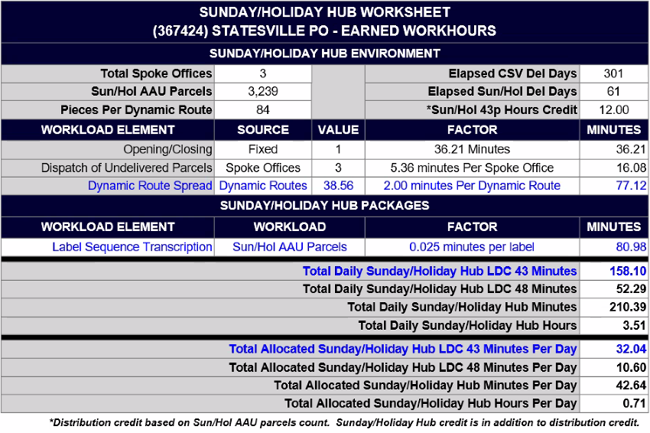
CSV Menu – Sunday Hub
Specific to offices identified as Sunday/Holiday hubs with National Service Agreements for parcel delivery
Hubs are established and maintained by Headquarters PO Operations and Field Support
Summary of workload and earned hours associated with hub activity
Provides total earned minutes per day for LDC 43A and LDC 48 workload
Provides total daily earned minutes and hours per day

Slide 24
Ways to monitor and increase your CSV %
8. Transfer hours to training used
9. Use in combination – Flash, LTATS,
Station Summary, TACS & CSAW
to accurately record time
10. Ensure Flash has been reconciled
before correcting transfers for pay
periods
11. Verify LTATS that no one has
transferred hours to you they
shouldn’t have or wrong amount
1. Allow leave with down time
2. Schedule to earned
3. Abolish jobs upon regular retirement
and repost new jobs if schedules
changed more than an hour
4. Have tentative schedule made for
possible staffing changes
5. Combine hours with loaned offices to
reach clerical guarantees
6. Transfer hours loaned out
7. Transfer hours to match earned in
each LDC

Slide 25
CSV Variance score
FY 23 CSV/SOV Scores
CSV/SOV Variance
Cells
1 / 2 / 3 / 4 / 5 / 6 / 7 / 8 / 9 / 10
77.5 / 81.88 / 86.25 / 90.63 / 95.00 / 103.00 / 111.00 / 119.00 / 127.00 / 135.00
CSV/SOV Variance
Current FY Earned hours = 1200
Dived by 1200/1250 = .96 X 100 = 96 (Cell 5 ) Cell 5 = 95.00
Current FY Actual hours = 1250

Slide 26
CSV Opportunity to SPLY
Cells
1 / 2 / 3 / 4 / 5 / 6 / 7 / 8 / 9 / 10
-99.99 / -70.00 / .40.1 / .10.1 / 19.98 / 35.98 / 51.98 / 67.98 / 83.99 / 99.99
CSV/SOV Opportunity % SPLY
Current % achieved – SPLY % achieved 96% - 97.5% = .015
Divide by .015 / 2.5 = .006 X 100 = -.60 = (Cell 2)
100% - SPLY Percent Achieved 100% - 97.5% = 2.5%
You take the greater of the two cells. CSV/SOV Variance = Cell 5
CSV/SOV Opportunity % SPLY = Cell 2
Your Score is a Cell 5

Slide 27
F2DPH Calculations
F2DPH |  |  | Cummulative
YTD Possible Deliveries | A |  | 1005219 |  | 1 | -5.00
YTD F2 Work Hours | B |  | 13907 |  | 2 | -3.69
YTD F2DPH | C | (A/B) | 72.281513 |  | 3 | -2.38
YTD F2 Packages | D |  | 176868 |  | 4 | -1.06
SPLY Possible Deliveries | E |  | 1009579 |  | 5 | 0.25
SPLY F2 Work Hours | F |  | 13970 |  | 6 | 3.20
SPLY F2 Packages | G |  | 218910 |  | 7 | 6.15
Package Volume Adjustment | H | (D - G) x 0.017 | -714.714 |  | 8 | 9.10
SPLY F2DPH | I | (E / (F+H) | 76.164256 |  | 9 | 12.05
F2DPH % SPLY | J | ((C / I) -1) x 100 | -5.097855 |  | 10 | 15.00
Refer J to NPA Cell Chart | K | Cell ____0__
FLASH Reference |  | Actual hours | 5273 | 4758
 |  | SPLY hours | 5224 | 466 | 300
 |  | Training hours | 515

