Slide 1

CMR Training
Atlantic Conference 2024

Slide 2
Member Representative Checklist
Determine if the client is a UPMA member.
Have the Member sign the Representation Authorization Form.
Supply Member with the UPMA Purpose Statement and UPMA Adverse Action Legal Defense Plan (AALDP).
Fill out the Member Contact sheet.
Discuss the Investigative Interview (PDI) process with Member.
Use this presentation as a guideline on how to prepare yourself and the Member for the Investigative Interview.
If you think this case may result in an Adverse Action as defined in ELM 651.71 or 652.2 please contact a National Member Representative.

Slide 3
Investigative Interview / PDI
Investigative Interview or PDI (Pre-Disciplinary Interview) is an interview with the discipling manager. The Interview goal is to answer questions in reference to allegations or performance issues.

Slide 4
Investigative Interview / PDI
EAS allowed a representative of choice
Take Notes—Review Questions; Determine Charges or Violation
EAS answers should only be short, precise, and do not elaborate
EAS—No Forum for Defense / Fact Finding
LESS IS MORE!
Ask to meet alone with Manager following II / PDI

Slide 5
Questions??

Slide 6
Roles during II / PDI
Representative:
The role of the Member Representative is to assist the Member to understand the procedures and guide them through the process.
Supporting the Member is a very integral part of a successful Investigative Interview. If possible meet with the Member 15 minutes prior to the interview.
If the Member has previous discipline ask for a copy of their discipline and a copy of their E-OPF.

Slide 7
Roles during II / PDI
Member:
The role of the Member is to be truthful in answering questions.
Remain Calm and relaxed.
Use the Investigative Interview to tell their side of the issue or to improve performance and correct deficiencies if needed.

Slide 8
Investigative Interview / PDI
Member or Member Representative should ask disciplining manager what the interview is about.
Ask for copies of the questions. Not always granted!
Member should answer questions to the best of his/her knowledge.
Do not provide more information than is requested.
Member answers should be short and precise but not evasive.

Slide 9
Investigative Interview / PDI
The Interview may be done in person or over the phone.
Over the phone, have Member Representative and Member together during the interview or on another line.
In person, have Member Representative attend with the Member.
Advise Member not to be interviewed alone or answer questions on the phone without a witness.
Inform Member to not let disciplining manage talk him/her into attending the meeting alone. I.E.: “I just want to ask a few questions.”

Slide 10
Questions??

Slide 11
Investigative Interview / PDI
.
Request a break if you need to talk with member in reference to how he/she is answering the questions.
The Member should ask for a break if he/she does not understand the questions.
Member Representative or Member can ask questions at the Investigative Interview.
If the Member knows they have done something wrong and might be receiving some type of discipline other than a removal or downgrade, advise Member it is best to be humble and remorseful when answering the questions.

Slide 12
Investigative Interview / PDI
If the Manager is being hostile towards the member, stop the Interview.
Once the interview has been completed, if appropriate ask what type of discipline he/she is considering.
You may be able to use this time to discuss a settlement for the member.
Use the questions to prepare for your negotiation for a settlement for the Member.

Slide 13
Reaching a settlement
Creating settlements when the manager doesn’t want to reduce discipline.
Access situation from both sides, Manager and MPOO
Be prepared to address disciplinary actions/issues
Have a goal set or be fully prepared to settle the case.
Take good notes from phone conversations.
Follow-up email summarizing phone conversation
Keep a copies of all communications

Slide 14
PIP (Performance Improvement Plan)
Alternative Means to correct repeated issues.
Produces List of what improvement is needed – Ask PM/Manager for Input. PM/Manager can provide obstacles in achieving goals.
MPOO/Manager shows support / Offers Training.
Set time frame to achieve goals.
If PM/Manager cannot meet goals – Notify MPOO/Manager in writing – Give valid reasons.
At end of time frame, if achieved, PM/Manager should be cleared.
Failed goals, MPOO/Manager may allot more time or discipline may follow.
Manager/PM should always have a representative with him/her.
The KEY in the PIP Process is communication.

Slide 15
Questions??

Slide 16
Mediation
Alternate Dispute Resolution
Redress—EEO
Mediation – ELM 650
ADR is voluntary
Set rules of evidence are presented

Slide 17
Mediation
Mediator – Neutral
Mediator does not offer solutions
Mediation is confidential
Main Goal – Get a settlement
Each Party explains/details story

Slide 18
Mediation
Mediator clarify/identify issues
Mediator can identify options and discuss effect for possible solutions
Any documents used may not be siphoned for hearing/trial
Mediator and parties will not testify about mediation

Slide 19
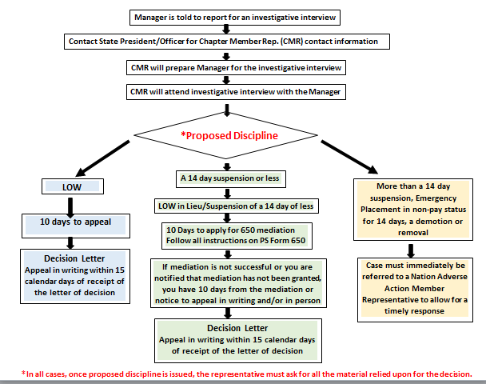

Slide 20
Questions??

Slide 21
Most Common EAS Errors
Settling grievances over settlement authority
Misuse of Postal Funds
Falsified records/TimeCards/TACS
Untimely Audit of Credits
SOX Irregularities-Retail, Credit Card, eBuy concerns

Slide 22
Most Common EAS Errors
Reporting Irregularities, delayed/undelivered mail
Failure to Dispatch mail
Misuse of Computer (Excessive Personal use, web-surfing, improper email use, etc.)
Alcohol/Drug Abuse
Sexual Harassment
Sending MPOO inappropriate email

Slide 23
Adverse Action
651.71 Definition
Adverse actions are defined as discharges, suspensions of more than 14 days, furloughs of 30 days or less, and/or reduction in grade or pay.
Letter in Lieu of 7 day and 14 day suspensions.
Reduction in grade
Removals
Emergency Placements in excess of 14 days
Letter of Warning are NOT Adverse Actions
651.72 Policy
Adverse action may be taken against an employee (a) because lesser measures have not resulted in the correction of deficiencies in behavior or performance, (b) because of the gravity of the offense, or (c) for non-disciplinary reasons, such as the correction of a position misranking.

Slide 24
Emergency Placement
651.4 Emergency Placement in Off-Duty Status
An employee may be placed in an off-duty non pay status immediately but remains on the rolls when he or she (a) exhibits characteristics of impairment due to alcohol, drugs or other intoxicant, (b) fails to observe safety rules, (c) fails to obey a direct order, (d) provides reason to be deemed potentially injurious to self or others, or (e) disrupts day-to-day postal operations in any other way.
Placement in an off-duty non pay status is confirmed in writing, stating the reasons and advising the employee that the action is appealable. The employee should be returned to duty after the cause for non pay status ceases unless the individual circumstance warrant otherwise. Use of the emergency procedures does not preclude disciplinary action based on the same conduct.

Slide 25
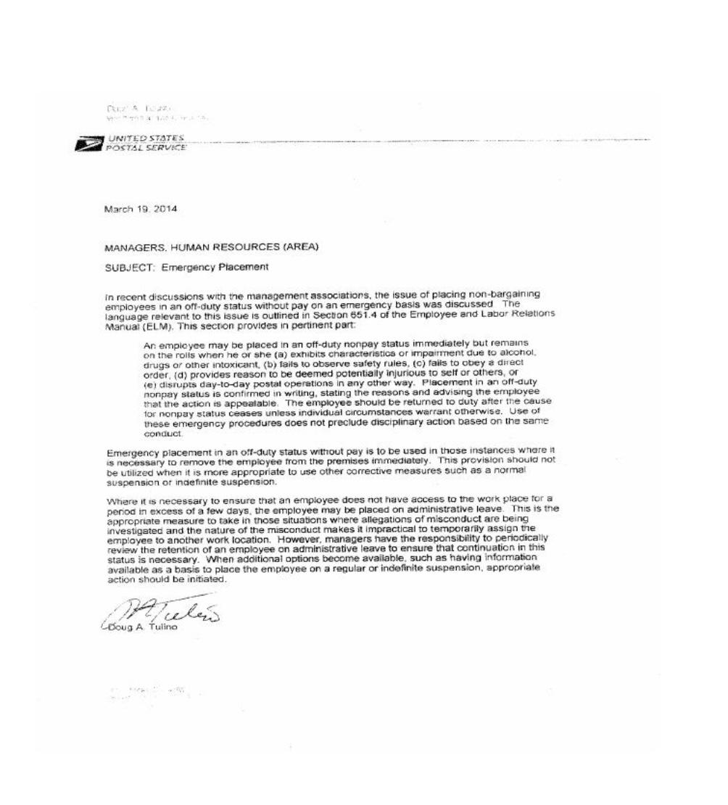

Slide 26
Questions??

Slide 27
Consultative Process
Consultative Process is one of the fastest ways to have, District actions at the local level, resolved when not complying with Headquarters directions. They are resolved by passing the MPOO if no satisfactory answers have been given for additional or detrimental directions being levied to District Postmasters.
This is not and Adverse Action Committee Process.

Slide 28
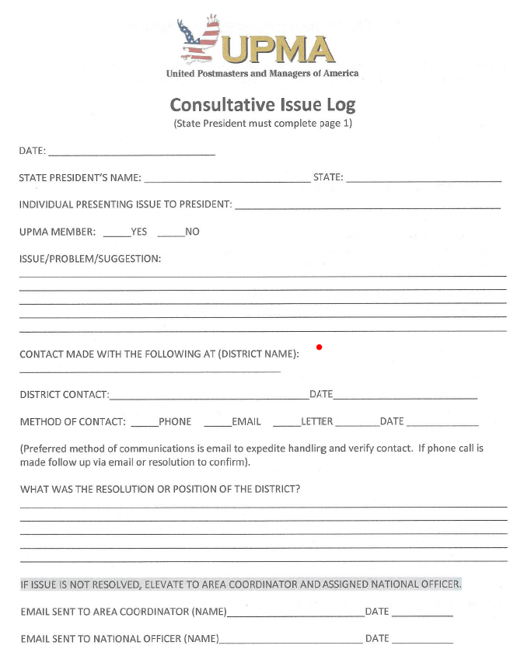
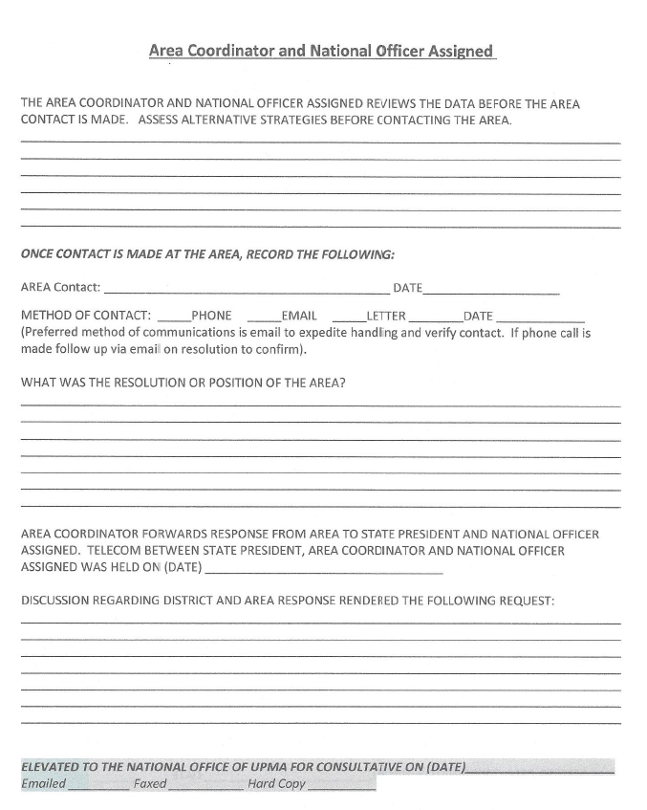

Slide 29
Reasons for OIG Visits
OIG Team assignments:
Random
District Request
Flagged Items
“Whistleblower Employee”
Serious Infractions:
Disregard of Postal Regulations
Revenue losses due to Inattention
False entries on Time Cards, TACS
Reoccurring deficiencies of a Serious Nature
Disciplinary action will follow
Criminal

Slide 30

OIG Interviews
    Interview employees under oath
  Review agency documents
  Subpoena individuals to provide the OIG with documents
  Place employees under arrest; and
  Inform the Attorney General and local United States
  Attorney of any potential criminal violations.
Notes:
The OIG's mission is to seek out and eliminate employee fraud, waste, and abuse within the Postal Service. In order to carry out its mission, the OIG has the statutory authority to: Interview employees under oath;
Review agency documents;
Subpoena individuals to provide the OIG with documents;
Place employees under arrest; and
Inform the Attorney General and local United States
Attorney of any potential criminal violations.

Slide 31
OIG Interviews
The OIG does not have the legal authority to:
  a. Physically threaten or intimidate employees; or
  b. Order employees to appear for interviews or discipline
  employees if they refuse to appear or cooperate.
Notes:
Read Text - [This (B) is a technicality easily circumvented by the OIG requesting any management official to direct employees to appear or
recommending to management that employees be disciplined for failure to comply.]

Slide 32
OIG Interviews
Who are, Garrity, Kalkines and Miranda?
What do they have to do with OIG Interviews?
Why do you need to know?
Notes:
Read Text

Slide 33
OIG Interviews
GARRITY WARNING
You are being asked to provide information as part of an internal
and/or administrative investigation. This is a voluntary interview
and you do not have to answer questions if your answers would
tend to implicate you in a crime. No disciplinary action will be
taken against you solely for refusing to answer questions.
However, the evidentiary value of your silence may be
considered in administrative proceedings as part of the facts
surrounding your case. Any statement you do choose to provide
may be used as evidence in criminal and/or administrative
proceedings.
Notes:
Summarize Text This is intended to preserve the OIG’s ability to use your answers against you in any criminal proceeding. You are told that the interview is completely voluntary, and if you choose not to answer you cannot be disciplined for that refusal. This does not necessarily mean that there is an interest in prosecuting you. But it does mean that they think you may have knowledge of alleged criminal activity.

Slide 34
OIG Interviews
KALKINES WARNING
You are being questioned as part of an internal and/or
administrative investigation. You will be asked a number of
specific questions concerning your official duties, and you must
answer these questions to the best of your ability. Failure to
answer completely and truthfully may result in disciplinary action,
including dismissal. Your answers and any information derived
from them may be used against you in administrative
proceedings. However, neither your answers nor any
information derived from them may be used against you in
criminal proceedings, except if you knowingly and willfully make
false statements.
Notes:
Read Text This is given when the OIG is not pursuing criminal prosecution against you. In that case, you will be compelled to answer questions at the risk of losing your job, but your answers may not be used against you in any criminal prosecution. This does not mean there will not be a criminal prosecution. The use of that warning simply means that the government is not planning a criminal prosecution at that moment.
ELM 665.3 requires employees to “cooperate in any postal investigation, including Office of Inspector General investigations.”

Slide 35
OIG Interviews
Miranda Rights
You have the right to remain silent. Anything you say can be
used against you in court. You have the right to talk to a lawyer
for advice before we ask you any questions. You have the right
to have a lawyer with you during questioning. If you cannot afford
a lawyer, one will be appointed for you before any questioning if
you wish. If you decide to answer questions now without a lawyer
present, you have the right to stop answering at any time.
Notes:
Read Text - This is given to subjects of OIG investigations when they are placed under arrest or in custody and facing arrest. Under those advertisements, you have the right to remain silent and you have the right to an attorney

Slide 36
Results of OIG Investigative Interview
OIG or Inspectors will Submit a ROI or MOI Level (Report of Investigation, Memorandum of Interview) to Next Higher USPS
Almost always an investigative interview with MPOO will be given before Discipline

Slide 37
Questions and Answers

Slide 38
What should I do if I am scheduled for an Investigative Interview?
1. Immediately call your CMR or Chapter President.
2. DO NOT PARTICIPATE OR answer any questions without representation. Investigative Interviews are stressful enough, and you always need someone taking copious notes for you to help defend you

Slide 39
What should I do if my boss wants to have a conversation about something that could potentially lead to discipline?
1. Ask your boss could this lead to disciplinary action?
2. Take copious notes on the questions you ask your boss
3. Never be afraid to ask for representation, it's your right to have someone looking out for your best benefit

Slide 40
Can my boss tell me I have to participate in an Investigative Interview without representation?
1.No, ELM 651.2, VOL March 2021, Representation
Subject to prohibitions regarding Executive and Administrative Schedule
(EAS)/Craft representation, employees have free choice of representation.
Representatives designated by employees, if postal employees and if otherwise in a duty status, are granted a reasonable amount of official time to respond to notices of proposed disciplinary action, to prepare for and represent the employee at a hearing held in accordance with 652.24, and/or to represent an employee who has appealed a letter of warning or emergency placement in a non duty status in accordance with 652.4.
Employees covered under these provisions may request representation during investigative questioning if the employee has a reasonable belief disciplinary action may ensue.

Slide 41
What should I do if the OIG or USPIS show up and want to interview me?
You should immediately read them the following:
I request the presence of my UPMA representative. If I am a suspect in a criminal matter, please do advise me. If so, I wish to contact my representative. If I am under arrest, I request you to so advise me and to inform me of the reason or reasons. I will not resist an arrest. I do not consent to a search of my person or property. However, O will not physically resist or obstruct such a search. If you have a search warrant, I request to see it at this time. I will cooperate with you fully, but I do not waive any of my rights, including my right to remain silent. I will not sign a waiver-of-rights form, not admit or deny any allegations, nor make any written or oral statements unless my attorney and/or a UPMA representative are personally present and so advise me.

Slide 42
Do I have to cooperate with a postal investigation?
Yes, ELM 50 665.3, March 2021
Employees must cooperate in any postal investigation, including Office of Inspector General Investigations

Slide 43
Questions??

